Slide 1
Housing line chart

Slide 2
Why
To show the ridiculousness of the American lifestyle
To show that many of the problems that Americans have with regards to money are self-inflicted wounds
We’re buying bigger houses even though families are getting smaller
It’s not like we were living in shacks in the 1970s either
It’s just waste and inefficiency, and it’s driving us into debt and making us miserable
Have a sort of “d3 rant”
Visualize mustachianism

Slide 3
Data
Household size data
https://www.statista.com/statistics/183648/average-size-of-households-in-the-us/
Housing square footage data
https://www.census.gov/construction/chars/pdf/c25ann2014.pdf
Data were manually entered into csv format
Three columns: year, housing size, and household size
Row for each year

Slide 4
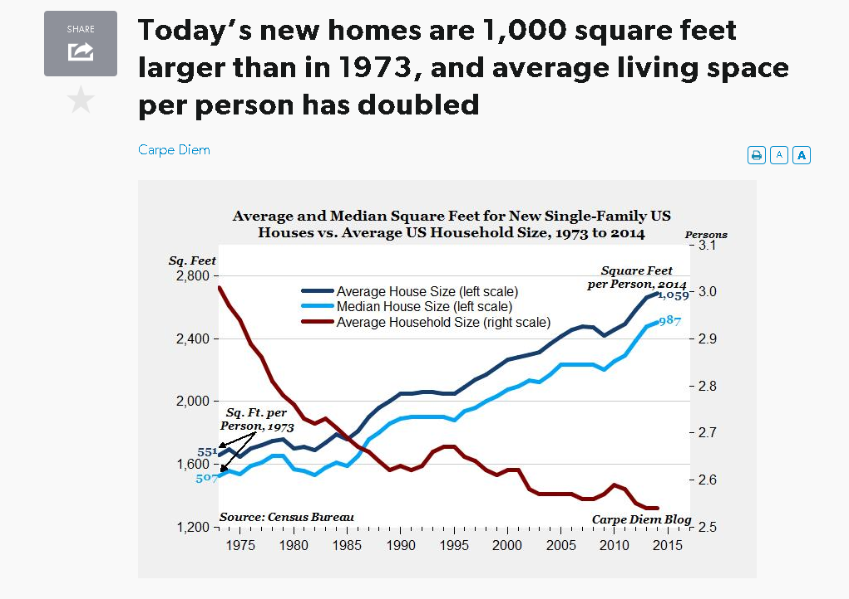
Idea
Reproduce this chart
Add tooltips for data
This chart comes from AEI: a right-wing think tank
https://bit.ly/1BRuIl5
The article that accompanies the chart focuses on the expanding material wealth of Americans as a sign of prosperity, in contrast to the “sky is falling” narrative that’s constantly present in the media

Slide 5
Expansion of chart message
Housing costs per square foot have remained constant
But house sizes have increased
So, the price of a house has to have increased
Seeing that wages have remained stagnant for decades
Can we conclude that the increased housing costs are fueled by debt?
I could make a separate visualization focusing on the various forms of debt in the average American household

